Slide 1
EDUTECH
The place to explore

Slide 2
TEAM- MASTER MINDS
Team Members
Ananthita A Padmesh
Aswathy Manoj
Devipriya M S
Ardhra Manoj

Slide 3
INDEX
Introduction
Objective
Problem statement
Area of the project
Skills Required
Website Layout
Conclusion

Slide 4
INTRODUCTION
The web today has an answer to all our queries.In case of educational web development,it is not limited to institutional websites,but it extends to many stand-alone educational web development including self learning courses,syllabuses information,course information,learning assets and much more.
The main motive of our project was to create a website that helps the users stay up to date with the latest technological trends by providing wide range of options such as expert advices,latest educational news,journals and others related to technical field.

Slide 5
OBJECTIVE OF THE PROJECT
To offer informative, helpful and educational content to people.
Provide a platform to share your knowledge with others.
The site help people to create content with a focus so that your blog isn’t a bunch of rudderless articles in a sea of content.
Attract audiences.
Share your thoughts and questions with experts.

Slide 6
PROBLEM STATEMENT
Staying Up-To-Date With Modern Tech.

Slide 7
AREA OF THE PROJECT
The website helps its users get a head start with latest tech updates by providing quality content.
It serves as a useful guide for gadgets and products by providing articles on product review and information.
Provides informative journals/articles in the areas of science and engineering.
Serves as an interactive platform by providing a forum through which the users get to seek expert opinion as well as post their articles.

Slide 8
SKILLS SET REQUIRED FOR THE PROJECT
Understanding of Html CSS & javascript.
Ability to write quality content.
Team Work

Slide 9
WEBSITE LAYOUT

Slide 10
HOME PAGE
All articles are featured in the home page.
Users can search for the topics they need.
Notification for every articles and journals published on the site will be shown for the subscribed users.
Video:
https://drive.google.com/file/d/1jdHTIzRDkhf3UzrXDEYSah_Sof_WnEVE/view?usp=sharing

Slide 11

2. LOGIN PAGE

Slide 12
Through this page the users can login to the website by providing their username and password.
There is also an option for the users to create an account if they already do not have one.

Slide 13
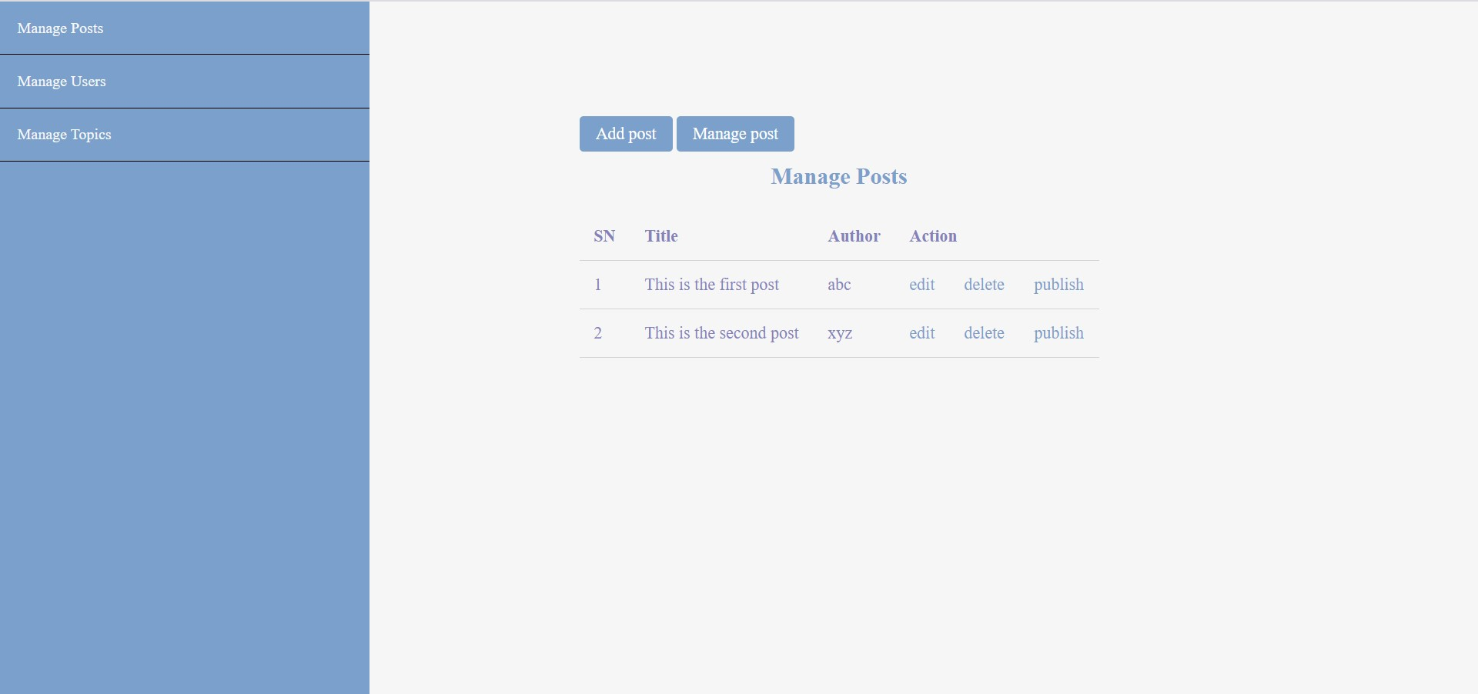
Admin Page

Slide 14
Manage Post-The articles posted by the users are displayed and there is an option for the users to add new articles.
Manage Topics- Users can add more options for topics of their choice.
Manage Users-The name of the user along with their positions are displayed and there is an option for new users to create an account by providing necessary details and choose the position that they want such as an author or admin.

Slide 15
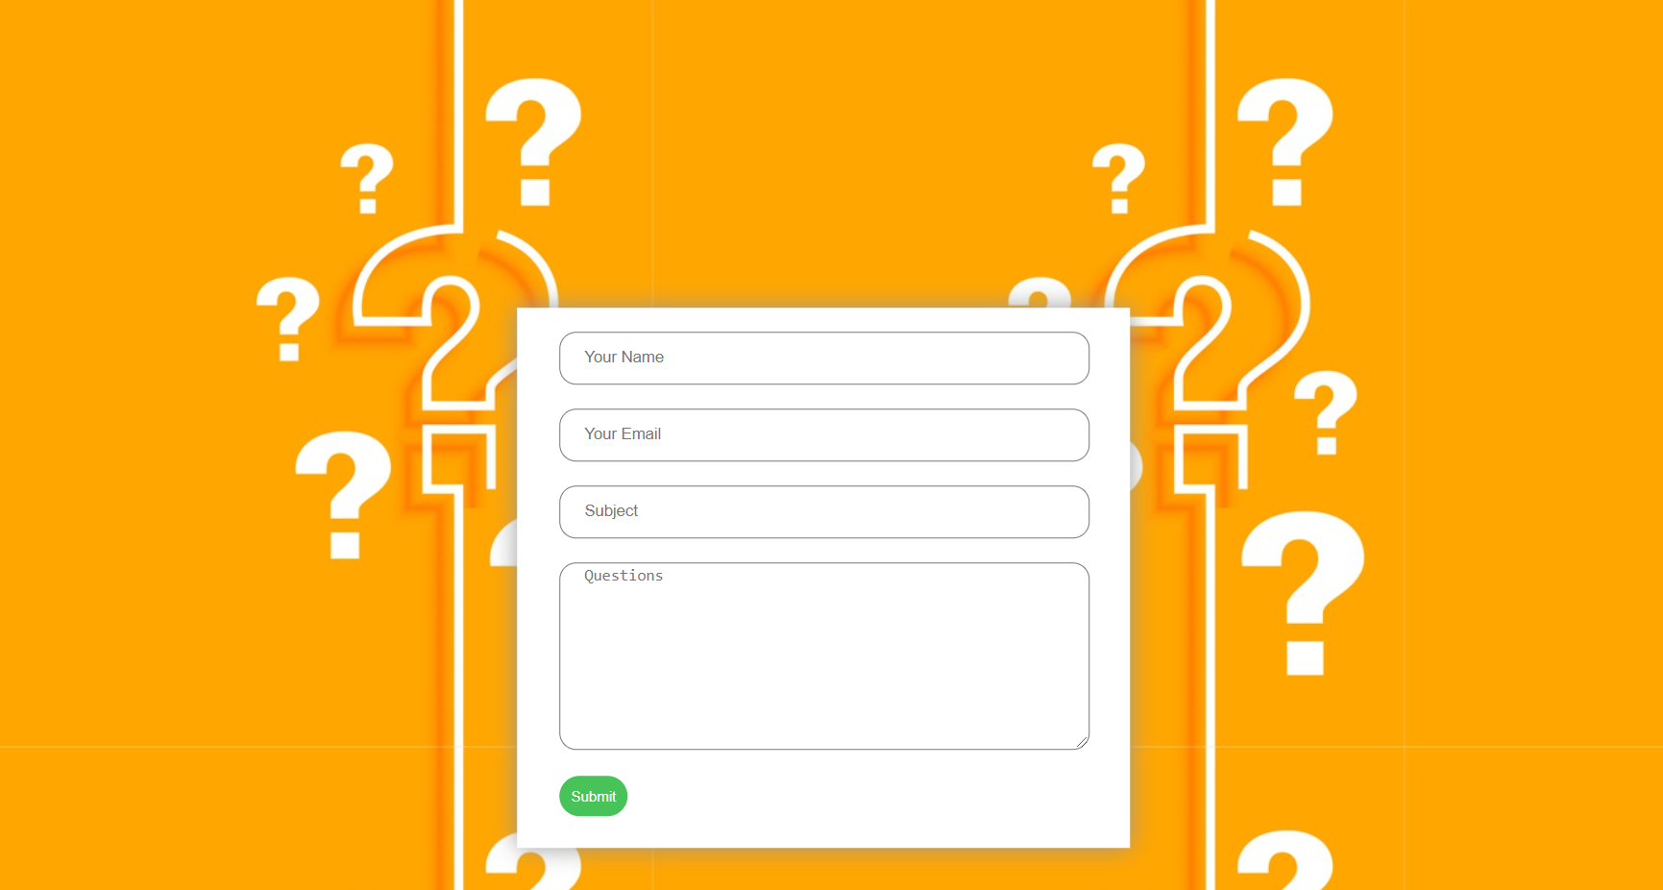
3. ASK EXPERTS

Slide 16
Ask Expert page helps you to solve your queries with our expert panel.
You can enter your name, email and then ask your question.
You will be notified soon with an answer from our experts.

Slide 17
4. EVENTS
All the upcoming events will be published in this page.
Users can find out the events in which they are interested and can register for the same.
Registrations can be done easily by clicking the photo of the event.
This would redirect the user to the registration forms of respective organisations.
Video:
https://drive.google.com/file/d/1oVtlBx8PaxICHZtHQrO4jcthWgbmPgdO/view?usp=sharing

Slide 18
CONCLUSION
EDUTECH helps the student to explore into the technical field.
It provides an opportunity for them to interact with the educational experts and clear their queries.
Gives quick information about the upcoming webinars,hackathon,tech events and so on.
Creates platform to express your views and ideas through blogs and articles.

